Slide 1

COM7401 Research Methods
Research Questions and the Funnel Strategy
Week 2 – Session 1

Slide 2

By the end of the session, you should be able to…
Define a research problem and explain why it matters in CS, DA and CY
Distinguish the main types of research question
Explain how your stance shapes the questions you can ask
Apply the Funnel Strategy to narrow your topic to a draft research question

Slide 3

What’s it all about
Many academic researchers are uncertain how to identify and craft the research problem to be addressed in the inquiry and how to frame the main research question.
You must conceptualize a research idea, set the scope of the research problem and consider whether the problem is researchable (Pajares, 2007). Challenging huh?!
Formulating clear and precise research problems is crucial in order to help you define your research questions, hypothesis and research design.
Notes:
Considering your research problem carefully you can step into writing a series of well-defined research questions that will serve as the foundation to your study. The research questions and the research problem (problem domain) can help you with the research design by focusing your attention on not only the specific issue but also help you maintain focus increase efficiency and lead to meaningful results

Slide 4
Check-in: your literature search
Have to hand: your topic, your search log and your three sources
Which source is your candidate for critical appraisal in Session 2?
What gap or unanswered question did you notice while searching?
Today you will use these sources in the Funnel

Slide 5

What is a Research Problem?
Definition (always a good start).
A research problem is a clearly defined issue that the researcher intends to address or a gap in knowledge that requires exploration.
It sets the focus and purpose for the study and guides all decisions on methods, analysis, and evaluation.
Why is the research problem important?
  It allows for the creation of a specific research question that narrows the scope of the study.
  Helps justify the study’s relevance and contribution to knowledge.
Application in CS, DA, CY:
CS: Tackling inefficiencies in algorithm design.
DA: Addressing the challenge of handling large-scale unstructured data.
CY: Responding to increasing phishing attacks in healthcare organizations.
Notes:
Stress to students that identifying a research problem is akin to identifying a precise target. Without this focus, research becomes scattered and loses its contribution to subject field.

Slide 6

Interdisciplinary Nature of Research
Why is interdisciplinary research important?
Example
Real-world problems are rarely confined to a single field. Cross-disciplinary research allows for the integration of techniques from different fields to provide robust solutions.
CS & CY: Using machine learning algorithms to identify security vulnerabilities (CS expertise applied to a CY problem).
DA & CY: Analysing big data to understand trends in cyber-attacks (DA techniques applied to CY datasets).
CS & DA: Improving data processing algorithms to enhance real-time data analysis (CS algorithms enhancing DA).
Impact:
Find solutions that address multiple facets of a problem: technical (CS), analytical (DA), and security-oriented (CY).
Example: Building an AI-powered system for anomaly detection in cybersecurity uses all three disciplines.

Slide 7

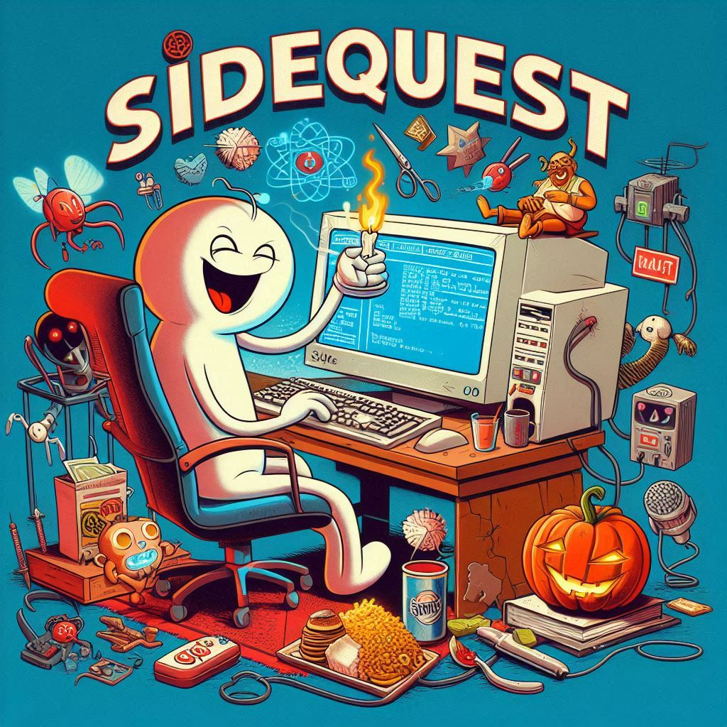
LIGHTNING RESEARCH
Generating Interdisciplinary
Research Topics – 15 mins
Objective:
To identify and formulate research topics that integrate concepts from Computer Science, Data Analytics, and Cybersecurity.
Task Description:
Create a Venn Diagram with three areas labelled CS, DA, CY
In each Circle note down 5-7 core topics or technologies in that field. (see week1 to help)
Identify overlapping areas
Look at the intersections between CS &DA, DA and CY, CS and CY. In each overlapping section, write down topics that combine elements from both fields.
Example: For Computer Science & Data Analytics, consider "Developing new machine learning algorithms.“
Central Intersection:
Focus on the central area where all three circles overlap. Brainstorm topics that integrate all three fields.
Example: "Designing AI-driven systems for real-time cybersecurity threat analytics."
Notes:
Example Topics Generated:
AI-Powered Cybersecurity Analytics: Developing machine learning models to detect and predict cyber threats using big data.
Secure Data Mining Algorithms: Creating algorithms that ensure data privacy and security during the data analysis process.
Blockchain for Data Integrity: Investigating how blockchain technology can secure data transactions and analytics.
Real-Time Anomaly Detection Systems: Designing systems that analyze network data in real-time to identify security breaches.
Privacy-Preserving Data Analysis: Exploring methods to perform data analytics without compromising sensitive information.

Slide 8
Types of research question
Describing, comparing, testing
Exploring and predicting
Descriptive – what is happening? What are its characteristics?
Comparative – how do A and B differ?
Causal – does X cause Y?
Relationship-based – how are X and Y related?
Exploratory – investigate an unfamiliar area
Predictive – what future outcome can we forecast?
Interpretive – what do people experience or mean?
The question-types pre-reading deck has full detail and examples.

Slide 9
Stance shapes the question
Positivist
Interpretivist
Pragmatist
Often asks: causal, comparative, predictive, relationship-based questions
Typical wording: “Does…?”, “What is the effect of…?”
CY example: “What is the effect of two-factor authentication on successful phishing attacks?”
Often asks: exploratory and interpretive questions
Typical wording: “How do… experience / interpret / understand…?”
CY example: “How do cybersecurity professionals understand and interpret insider threats?”
Often asks: problem-led questions, often mixed
Typical wording: “What works for…?”, “How can we improve… and how well does it work?”
CY example: “How can a phishing-reporting tool be designed so staff use it, and does it reduce incidents?”
Check your draft question against your Stance Card: does it assume the stance you chose?

Slide 10
Constructing Effective Research Questions – A Checklist
Alignment with Philosophical Foundations:
Is the research question consistent with your ontological and epistemological stance?
Clarity and Focus:
Is the research question clear and precise? Does it avoid ambiguity?
Feasibility:
Can the question be answered within the available time, resources, and access to data?
Ethical Considerations:
Does the question respect ethical guidelines and take into account the values associated with the topic?

Slide 11
Examples of Well-Constructed Research Questions
Computer Science (CS):
Descriptive: "What are the current trends in neural network optimization for natural language processing?"
Comparative: "Which algorithm, A or B, performs better in detecting fraudulent transactions in real time?"
Causal: "How does the integration of quantum computing influence the efficiency of cryptographic algorithms?"
Data Analytics (DA):
Descriptive: "What are the key data points influencing customer lifetime value in e-commerce platforms?"
Comparative: "How do decision trees compare to random forests in predictive accuracy for healthcare data?"
Causal: "What factors contribute to the failure of predictive models in real-time stock market analysis?"
Cybersecurity (CY):
Descriptive: "What are the primary cybersecurity threats faced by small and medium-sized enterprises?"
Comparative: "How do different phishing detection methods compare in terms of false positives?"
Causal: "What is the impact of multi-factor authentication on the reduction of cyberattacks in healthcare systems?"

Slide 12
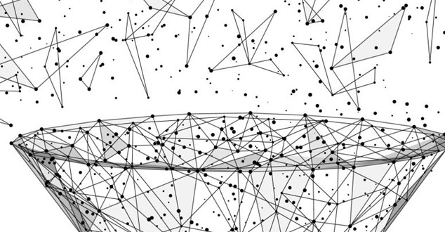
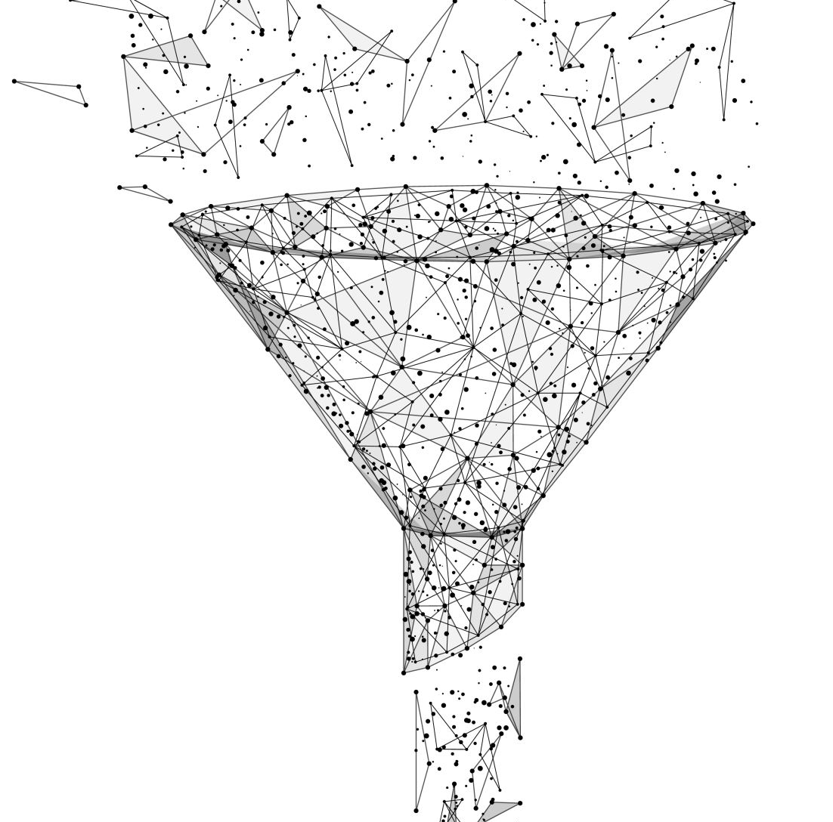
The Funnel Stratagem
Starting Point:
CY vulnerabilities
Funneling down: Insider threats within financial organizations
How effective are current monitoring systems in detecting insider threats in financial institutions?
A systematic, iterative approach to narrowing a broad research area down into a specific, actionable research question
Starts with an open-ended exploration of the general topic and gradually focuses on more specific problems.
Benefits of the Funnel Strategy:
  Provides a structured approach for researchers to move from a broad idea to a testable hypothesis.
  Helps eliminate noise and unnecessary information, enabling the researcher to focus on the core issue.

Slide 13
Applying The Funnel Stratagem
Step 1: Identify the Broad Subject Area:
  Example: Cybersecurity vulnerabilities in critical infrastructures.
Step 2: Review Literature to Identify Knowledge Gaps:
  Extensive literature review of both academic and industry reports to identify gaps (e.g., lack of research on cybersecurity for small and medium-sized enterprises).
Step 3: Narrow Down to a Specific Problem:
  Example: Narrow from cybersecurity in general to specific issues such as insider threats, particularly in the healthcare or financial sectors.
Starting Point:
CY vulnerabilities
Funneling down: Insider threats within financial organizations
How effective are current monitoring systems in detecting insider threats in financial institutions?

Slide 14
Funnel Strategy worksheet
About 60 minutes, individually or in pairs
1. Name your broad area (from your Stance Card)
2. Use your three sources to spot a gap
3. Narrow to a specific research problem
4. Write at least three research questions of different types that fit your stance
5. Peer review: clear, focused, answerable – and does it fit your stance?

Slide 15

Summary of Key Concepts
The formulation of research problems defines the success and scope of a study.
Research in CS, DA, and CY often overlaps and can benefit from interdisciplinary approaches.
The Funnel Strategy helps refine broad topics into specific researchable questions.
Different approaches to questions development will guide the type of inquiry and methods used.

Slide 16
Next: Literature Review and Critical Appraisal
This afternoon: reviewing and critically appraising literature
Bring your candidate source from the Literature Search Task
Thursday’s Zoom: Ethics Core
Then complete your Ethics Self-Assessment before Week 3, Session 1

Slide 17


From this point on…you’re a scientific researcher!
Congratulations
Mad or otherwise

Slide 18

Reflection & Writing – 10 Mins
Spend 10 mins just writing, you can either reflect on today’s lesson, capture ideas for a dissertation, reflect on today’s topics and how can they be applied to your research
Free write if you like also – just simply write.

Slide 19

Questions??
Or answers ?

